Slide 1




Java Syntax
Conditions, Loops, Methods, Objects, Collections
Java
Spring
SoftUni Team
Technical Trainers
Software University
http://softuni.bg

Slide 2


Table of Contents
Java Syntax
Variables and Operators
Conditions: if-else, switch
Loops: for, while, do-while, …
Methods, parameters, returning values
Objects and Classes
Arrays and Collections: ArrayList, Map, Set

Slide 3
Have a Question?
sli.do #fund-softuni

Slide 4

Welcome to Java!
IDEs, Comparison, Basic Syntax

Slide 5

Welcome to Java
Java is a statically-typed, object-oriented programming language
Very similar to C#
Variables’ types cannot be changed
In contrast to JavaScript and PHP where:
Code is not compiled
Types are dynamic

Slide 6
Hello World in Java
HelloJava class always stays in a file named HelloJava.java
HelloJava.java
The { stays on the same line
public class HelloJava {
public static void main(String[] args) {
System.out.println("Hello Java!");
}
}
Program entry point: main() method

Slide 7
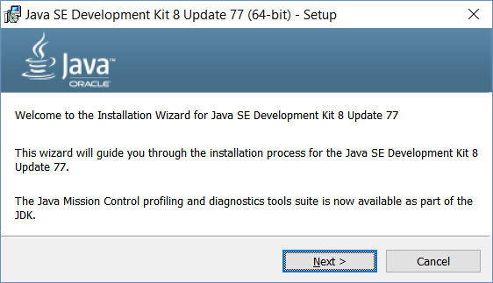
Installing Java
Download and install Java 8 SDK (JDK 8)
http://oracle.com/technetwork/java/javase/downloads/
Provides runtime environment (JRE) + compilers + tools
JRE (Java Runtime Environment)
https://java.com/en/download/
JRE is for end-users, not for devs
Developers should use JDK

Slide 8
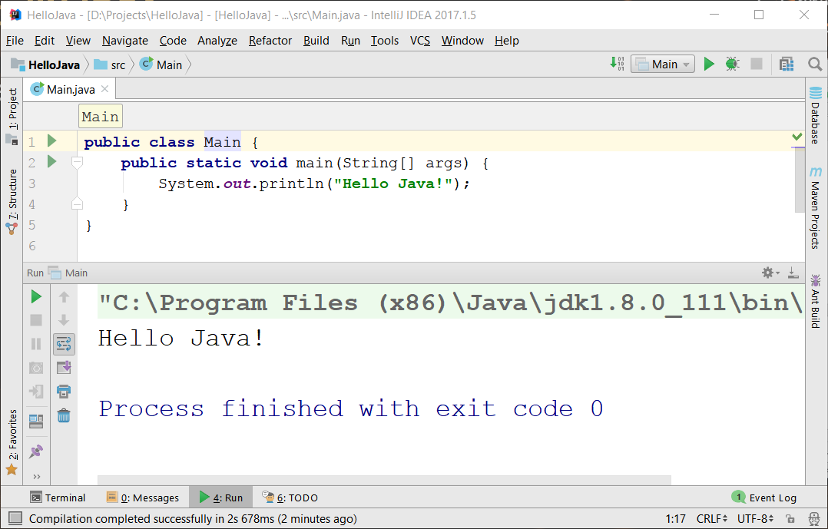
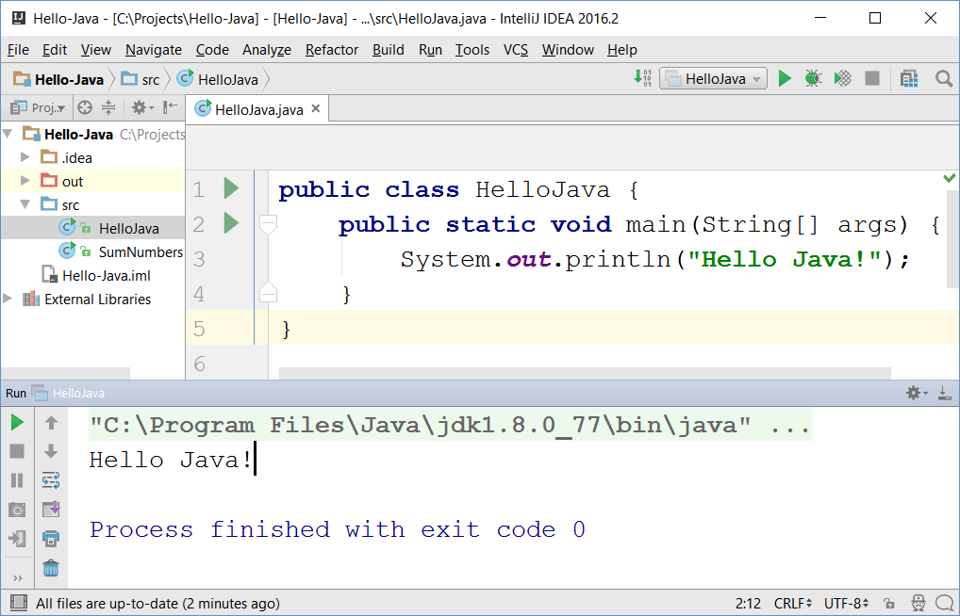

IntelliJ IDEA
JetBrains IntelliJ IDEA
Powerful Java IDE
Community edition (free)
Ultimate edition (commercial)

Slide 9
Basic Syntax
Variables, Operators

Slide 10
Variables and Operators in Java
Play with Java online:
www.javarepl.com
Define variables by their type
int i = 5; double d = 3; // i is integer, d is double
System.out.println(i + " ; " + d); // 5 ; 3.0
d = i * d; d++; // d = 16.0
System.out.println(d + 1); // 17.0
The ; separates multiple statements
String str = "Hello";
str = str + " Java";
System.out.printf("str = %s", str); // str = Hello Java
The %s is a string placeholder
System.out.print(s); // Compilation error: unknown symbol s

Slide 11
Problem: Sum Two Numbers
Write a Java program to sum two real numbers:
import java.util.Scanner;
public class SumTwoNumbers {
public static void main(String[] args) {
Scanner scan = new Scanner(System.in);
double num1 = Double.parseDouble(scan.nextLine());
double num2 = Double.parseDouble(scan.nextLine());
System.out.printf("Sum = %.2f", num1 + num2);
}
}
Check your solution here: https://judge.softuni.bg/Contests/Practice/Index/264#1

Slide 12
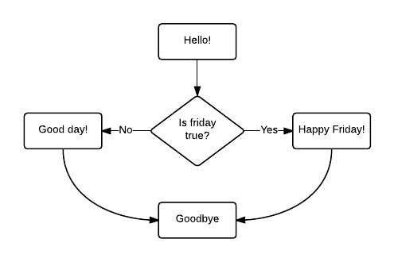
Conditional Statements
If/else, switch case

Slide 13
Conditions: if-else Statement
Java implements the classical if / if-else statements:
String currentDay = scan.nextLine();
String day = "Wednesday";
if (currentDay.equals(day)) {
System.out.println("It is Wednesday!");
} else {
System.out.println("Not Wednesday.");
}

Slide 14
Problem: Three Integers Sum
You are given 3 integers
Check whether the sum of two of them is equal to the third
Print the output in format a + b = c (where a ≤ b)
8 15 7
7 + 8 = 15
3 8 12
No
-5 -3 -2
-3 + -2 = -5
0 0 0
0 + 0 = 0
Check your solution here: https://judge.softuni.bg/Contests/Practice/Index/264#2

Slide 15
Solution: Three Integers Sum
public static void main(String[] args) {
Scanner scan = new Scanner(System.in);
int num1 = scan.nextInt();
int num2 = scan.nextInt();
int num3 = scan.nextInt();
if (!checkThreeIntegers(num1, num2, num3) &&
!checkThreeIntegers(num3, num1, num2) &&
!checkThreeIntegers(num2, num3, num1))
System.out.println("No");
}
Check your solution here: https://judge.softuni.bg/Contests/Practice/Index/264#2

Slide 16
Solution: Three Integers Sum (2)
static boolean checkThreeIntegers(
int num1, int num2, int sum) {
if (num1 + num2 != sum) {
return false;
}
if (num1 <= num2) {
System.out.printf("%d + %d = %d%n", num1, num2, sum);
} else {
System.out.printf("%d + %d = %d%n", num2, num1, sum);
}
return true;
}
%d ➔ int placeholder
%n ➔ new line
Check your solution here: https://judge.softuni.bg/Contests/Practice/Index/264#2

Slide 17
The switch-case Statement
Selects for execution a statement from a list depending on the value of the switch expression
int day = 3;
switch (day) {
case 1: System.out.println("Monday"); break;
case 2: System.out.println("Tuesday"); break;
case 3: System.out.println("Wednesday"); break;
…
case 7: System.out.println("Sunday"); break;
default: System.out.println("Error!"); break;
}

Slide 18

Loops
For, while, do-while, etc…

Slide 19
Loops: for, while, do-while, …
The for / while / do-while loops work as in C++, C# and Java
for (int i = 0; i <= 10; i++)
System.out.println(i); // 0 1 2 3 4 … 10
int count = 1;
while (count < 1024)
System.out.println(count *= 2); // 2 4 8 … 1024
String s = "ha";
do { System.out.println(s); s = s + s; }
while (s.length() < 10); // ha haha hahahaha

Slide 20
Problem: Sum N Integers in Java
import java.util.Scanner;
public class SumIntegers {
public static void main(String[] args) {
Scanner scan = new Scanner(System.in);
int n = Integer.parseInt(scan.nextLine());
long sum = 0;
for (int i = 0; i < n; i++) {
sum += Integer.parseInt(scan.nextLine());
}
System.out.println("Sum = " + sum);
}
}
5
10
20
30
40
-16
84
Check your solution here: https://judge.softuni.bg/Contests/Practice/Index/264#3

Slide 21
Methods in Java
Methods in Java hold a named piece of code
Can take parameters and return a result (strongly typed!)
Similar to functions in PHP / JS and methods in C#
static makes the method callable from main()
static int multiply(int a, int b) {
return a * b;
}
System.out.println(multiply(2, 3)); // 6 == 2 * 3
System.out.println(multiply(5)); // Compilation error

Slide 22
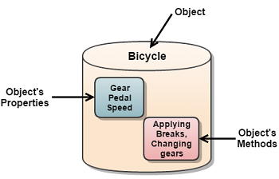
Objects and Classes
Definition, usage

Slide 23

Objects
In programming objects holds a set of named values
E.g. a rectangle object holds width and height
Creating a rectangle object:
Object name
rectangle
width = 5
height = 4
Object properties
The new operator creates a new object
Rectangle rectangle = new Rectangle();
rectangle.setWidth(5);
rectangle.setHeight(4);

Slide 24
Defining Classes
Rectangle.java
public class Rectangle {
private int width;
private int height;
public int getWidth() { return width; }
public void setWidth(int width) { this.width = width; }
public int getHeight() { return height; }
public void setHeight(int height) { this.height = height; }
}
Class declaration
Fields
Getters and setters

Slide 25
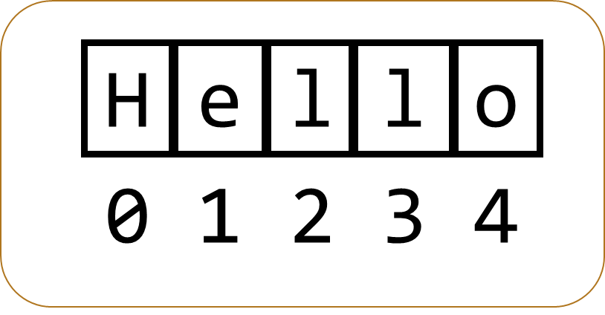
Strings
Declaring, comparisons, manipulation

Slide 26

Strings
Strings in Java
Know their number of characters: length()
Can be accessed by index: charAt(0 … length()-1)
Have reference type
Can have null (missing) value
Cannot be modified (immutable)
Most string operations return a new String instance
Low performance
Use the StringBuilder class to build stings quickly

Slide 27
Strings – Examples
String str = "SoftUni";
System.out.println(str);
for (int i = 0; i < str.length(); i++) {
System.out.printf("str[%d] = %s%n", i, str.charAt(i));
}
System.out.println(str.indexOf("Uni")); // 4
System.out.println(str.indexOf("uni")); // -1 (not found)
System.out.println(str.substring(4, 7)); // Uni
System.out.println(str.replace("Soft", "Hard")); // HardUni
System.out.println(str.toLowerCase()); // softuni
System.out.println(str.toUpperCase()); // SOFTUNI

Slide 28
Strings – Examples (2)
String firstName = "Steve";
String lastName = "Jobs";
int age = 56;
System.out.println(firstName + " " + lastName +
" (age: " + age + ")"); // Steve Jobs (age: 56)
String allLangs = "C#, Java; HTML, CSS; PHP, SQL";
String[] langs = allLangs.split("[, ;]+");
for (String lang : langs) {
System.out.println(lang);
}
System.out.println("Langs = " + String.join(", ", langs));
System.out.printf(" %n%n Software University ".trim());
Split by RegEx

Slide 29
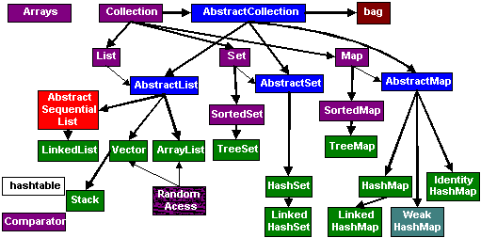
Collections
Arrays, ArrayList<>, HashSet<>, etc.

Slide 30
Arrays in Java
// Array holding numbers
int[] numbers = {1, 2, 3, 4, 5};
System.out.println(Arrays.toString(numbers));
// Array holding floating-point numbers
double[] numbers = {1.1, 5.44, 3.12, 4.4444, 5.0};
System.out.println(Arrays.toString(numbers));
// Array holding strings
String[] weekDays = {"Monday", "Tuesday", "Wednesday",
"Thursday", "Friday", "Saturday", "Sunday"};

Slide 31
Processing Array Elements
String[] capitals =
{"Sofia", "Berlin", "London", "Paris", "Moscow"};
capitals[0] = "SOFIA";
capitals[4] = null;
System.out.println(Arrays.toString(capitals));
// [SOFIA, Berlin, London, Paris, null]
for (String capital : capitals)
System.out.println(capital);
for (int i = 0; i < capitals.length; i++)
System.out.println(capitals[i]);
Traditional foreach loop
Traditional for-loop

Slide 32
Problem: Largest 3 Numbers
Write a program to read an array of numbers and find and print the largest 3 of them
10 30 15 20 50 5
20 30
10 5 20 3 20
50 30 20
30 20
20 20 10
Check your solution here: https://judge.softuni.bg/Contests/Practice/Index/264#5

Slide 33
Solution: Largest 3 Numbers
Scanner scan = new Scanner(System.in);
int[] nums = Arrays
.stream(scan.nextLine().split(" "))
.mapToInt(Integer::parseInt)
.toArray();
Arrays.sort(nums);
int count = Math.min(3, nums.length);
for (int i = 0; i < count; i++)
System.out.print(nums[nums.length - i - 1] + " ");
Java Stream API - similar to LINQ in C#
Check your solution here: https://judge.softuni.bg/Contests/Practice/Index/264#5

Slide 34
Collections: ArrayList<String>
ArrayList<String> names = new ArrayList<String>();
names.add("Peter");
names.add("Maria");
names.add("Katya");
names.add("Todor");
names.add("Nakov"); // Peter, Maria, Katya, Todor, Nakov
names.remove(0); // Maria, Katya, Todor, Nakov
names.remove(1); // Maria, Todor, Nakov
names.remove("Todor"); // Maria, Nakov
names.addAll(Arrays.asList("Alice", "Tedy"));
// Maria, Nakov, Alice, Tedy
names.add(3, "Sylvia"); // Maria, Nakov, Alice, Sylvia, Tedy
names.set(2, "Mike"); // Maria, Nakov, Mike, Sylvia, Tedy
System.out.println(names);

Slide 35
Collections: ArrayList<Integer>
// This will not compile!
ArrayList<int> intArr = new ArrayList<int>();
ArrayList<Integer> nums = new ArrayList<>(
Arrays.asList(5, -3, 10, 25));
nums.add(55); // 5, -3, 10, 25, 55
System.out.println(nums.get(0)); // 5
System.out.println(nums); // [5, -3, 10, 25, 55]
nums.remove(2); // 5, -3, 25, 55
nums.set(0, 101); // 101, -3, 25, 55
System.out.println(nums); // [101, -3, 25, 55]
Use wrapper Integer instead
Get item at index 0

Slide 36
HashSet<E> and TreeSet<E>
HashSet<E> doesn’t allow repetitions
TreeSet<E> keeps elements sorted
TreeSet<String> set = new TreeSet<String>();
set.add("Pesho");
set.add("Tosho");
set.add("Pesho");
set.add("Gosho");
set.add("Maria");
set.add("Alice");
set.remove("Pesho");
System.out.println(set); // [Alice, Gosho, Maria, Tosho]

Slide 37
Collections: Maps in Java
Maps in Java keep unique <key, value> pairs
HashMap<K, V>
Similar to Dictionary<T> in C#
Keeps a map of elements in a hash-table
Order of insertion is not preserved
TreeMap<K, V>
Similar to SortedDictionary<T> in C#
The elements are sorted by their key

Slide 38
HashMap<K, V> – Examples
Counting words occurrences in a list:
String[] words = { "yes", "hi", "hello", "hi", "welcome", "yes", "yes", "welcome", "hi", "yes", "hello", "yes" };
HashMap<String, Integer> wordsCount =
new HashMap<String, Integer>();
for (String word : words) {
Integer count = wordsCount.get(word);
if (count == null)
count = 0;
wordsCount.put(word, count+1);
}
System.out.println(wordsCount);
// {hi=3, yes=5, hello=2, welcome=2}

Slide 39
TreeMap<K, V> – Examples
Tracking students and their grades
HashMap<String, ArrayList<Integer>> grades = new HashMap<>();
grades.put("Peter", new ArrayList<>(Arrays.asList(5)));
grades.put("George", new ArrayList<>(Arrays.asList(5, 5, 6)));
grades.put("Maria", new ArrayList<>(Arrays.asList(5, 4, 4)));
grades.get("Peter").add(6); // add 6 to Peter's grades
grades.get("George").add(6);
for (String key : grades.keySet()) {
System.out.println("" + key + " -> " + grades.get(key));
}

Slide 40
Problem: Sums by Town
You are given a sequence of lines, each holding town + income
Write a Java program to sum the incomes for each town
4
Sofia | 200
Varna | 120
Pleven | 60
Varna | 70
Towns can appear multiple times
Pleven -> 60.0
Sofia -> 200.0
Varna -> 190.0
Order the towns by name
Check your solution here: https://judge.softuni.bg/Contests/Practice/Index/264#6

Slide 41
Solution: Sums by Town
TreeMap<String, Double> sumsByTown = new TreeMap<>();
for (int i = 0; i < n; i++) {
String[] tokens = scanner.nextLine().split("\\|");
String town = tokens[0].trim();
double income = Double.parseDouble(tokens[1].trim());
if (sumsByTown.containsKey(town)) {
sumsByTown.put(town, sumsByTown.get(town) + income);
} else {
sumsByTown.put(town, income);
}
}
for (String key : sumsByTown.keySet()) {
System.out.println(key + " -> " + sumsByTown.get(key));
}
Check your solution here: https://judge.softuni.bg/Contests/Practice/Index/264#6

Slide 42

Summary
Java is a statically-typed language
Java programs consist of classes
Program logic (variables, conditions, loops) are similar to C# / PHP / JavaScript
Arrays in Java hold sequences of elements
Java collections: list, set, map { key → value }
Objects in Java are class instances
Java is object-oriented language: relies on objects, classes, interfaces, methods, etc.

Slide 43








Software Technologies - Java Syntax
https://softuni.bg/courses/software-technologies

Slide 44
License
This course (slides, examples, demos, videos, homework, etc.) is licensed under the "Creative Commons Attribution-NonCommercial-ShareAlike 4.0 International" license

Slide 45





Trainings @ Software University
Software University Foundation – softuni.org
Software University – High-Quality Education, Profession and Job for Software Developers
softuni.bg
Software University @ Facebook
facebook.com/SoftwareUniversity
Software University Forums – forum.softuni.bg

